Slide 1
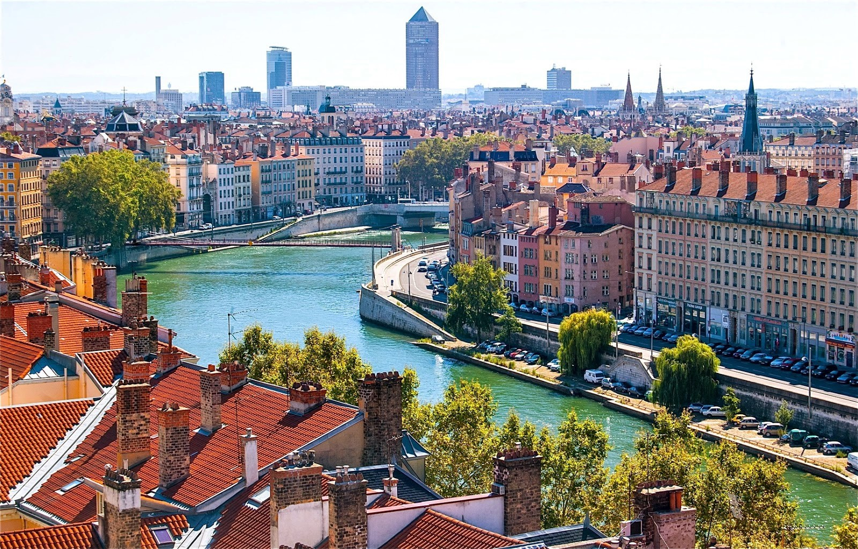
Lyon, France
An ancient city founded 2000 years ago.
Mr Aeckersberg French 7

Slide 2
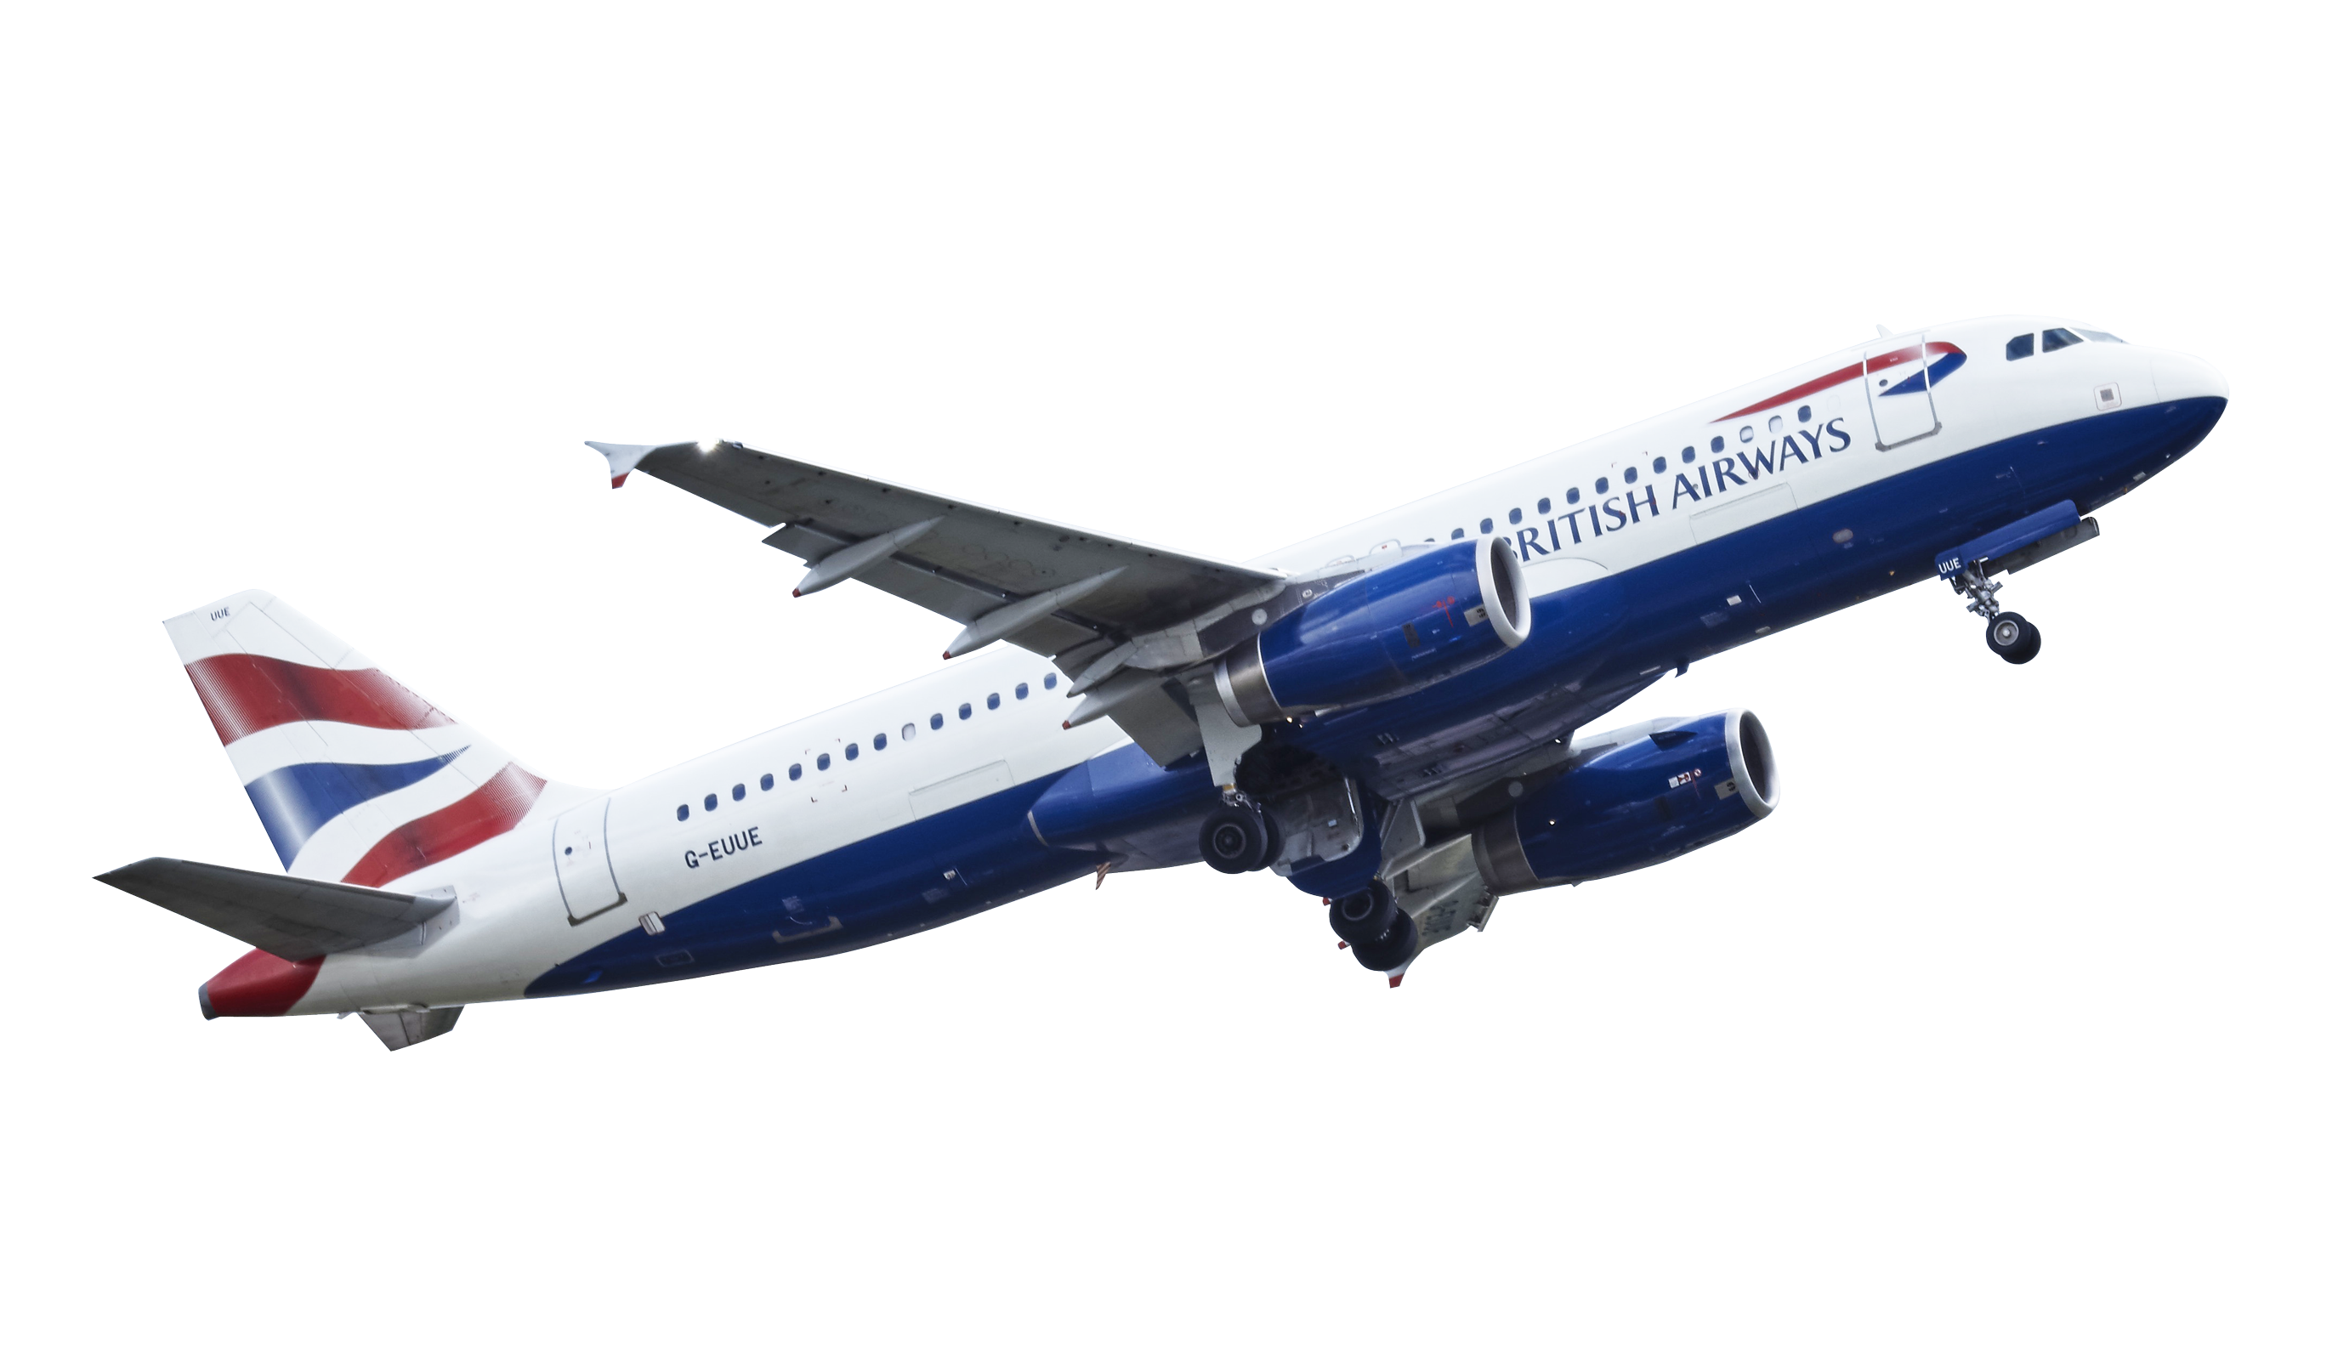
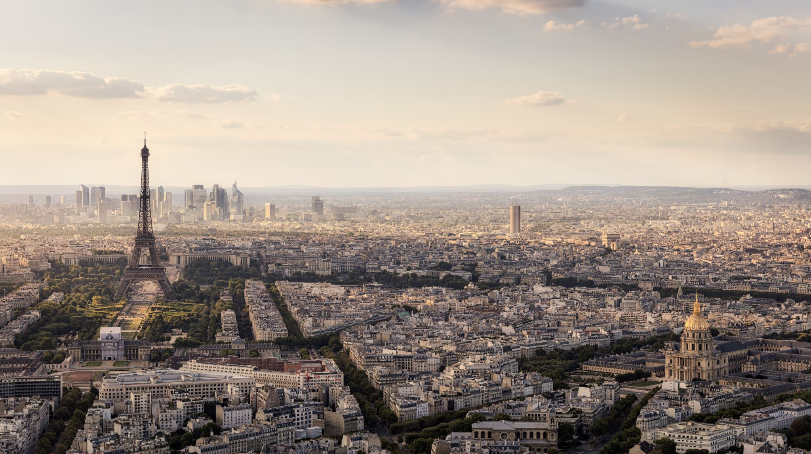
Paris ←-----→Kelowna
Departure: June 6, 2021 Paris → Toronto Depart: 09:15- Arrive 11:24
Air Canada Toronto → Kelowna 13:12 → 15:30
TOTAL COST: $1345.56
Return: June 13, 2021 Kelowna → Toronto Depart 14:45 – Arrive 23:34
Air Canada Toronto → Paris Depart 00:45- 13:36
This Photo by Unknown Author is licensed under CC BY-NC

Slide 3
The Delta Kelowna $135 per night x 7 nights TOTAL : $945
This Photo by Unknown Author is licensed under CC BY-SA

Slide 4
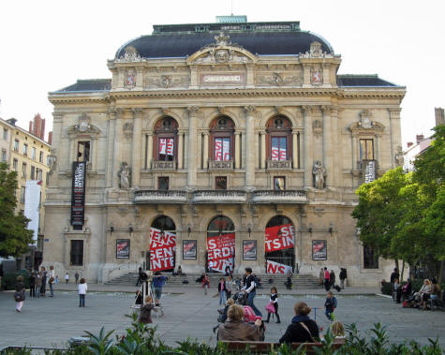
Celestins Theatre
The magnificent Celestins Theatre is one of the top destinations in Lyon France for theatre. Visitors to the city can enjoy top performances in this historical building.

Slide 5
French /English Dictionary
 | English word | French Word
1. | Lake | Lac
2. | To ski | Skier
3. | Wine | Vin
4. | Travel | Voyager
5. | Boat | bateau

